Slide 1
BHARATHI WOMAN’S COLLEGE
TOPIC: INDIA’S AGRICULTURE CROP PRODUCTION ANALYSIS(1997-2021)
INCHARGED BY
DR.S.LAVANYA MAM
PROJECT SUBMITTED BY
THAMIZHARASI.A
YASHIKA.N
VEERASELVI.T
JENSILA VINNARASI.A

Slide 2
India’s Agricultural crop Production Analysis(1997-2021)

Slide 3
Introduction
Agriculture is the backbone of the Indian Economy.
Around 58% population of india depends on Agriculute.
India ranks second worldwide in farm output.
India is the leading producer of jute, pulses.
Second largest producer of wheat, paddy, fruits, vegetables.
Agriculture the BIG idea for the developing nations.
The different definitions alluded to the fact that;
“ Agriculture is an ART and SCIENCE of managing crops and livestocks for ECONOMIC PURPOSES”

Slide 4
Purpose
Agriculture is the foundation of the Indian Economy.
The population of India mostly depends on agriculture for the livelihood and agriculture
contributes to 40% of the total GDP of the Country.
Supporting livelihoods through food, habitat and jobs.
Providing raw materials for food and other products.
Building strong economies through trade.

Slide 5
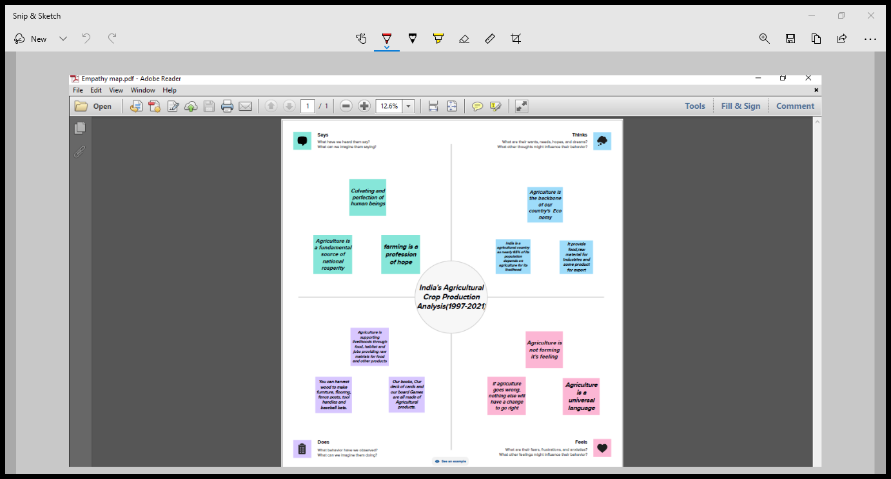

Slide 6
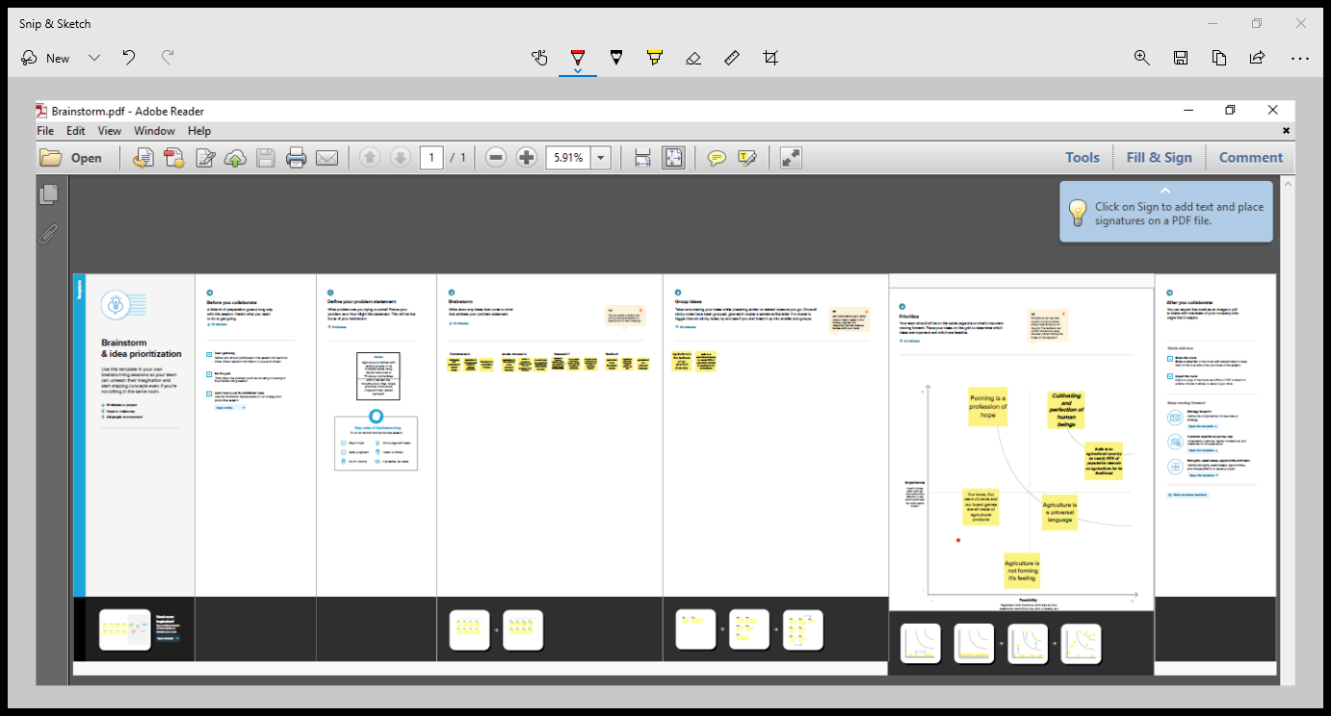

Slide 7
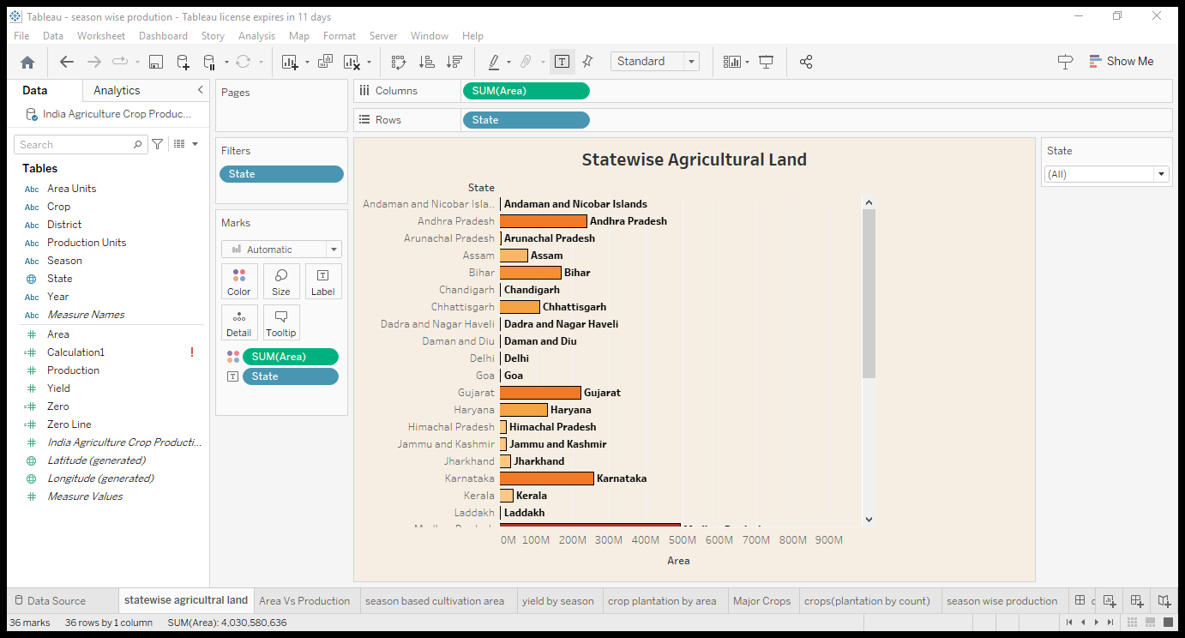

Slide 8
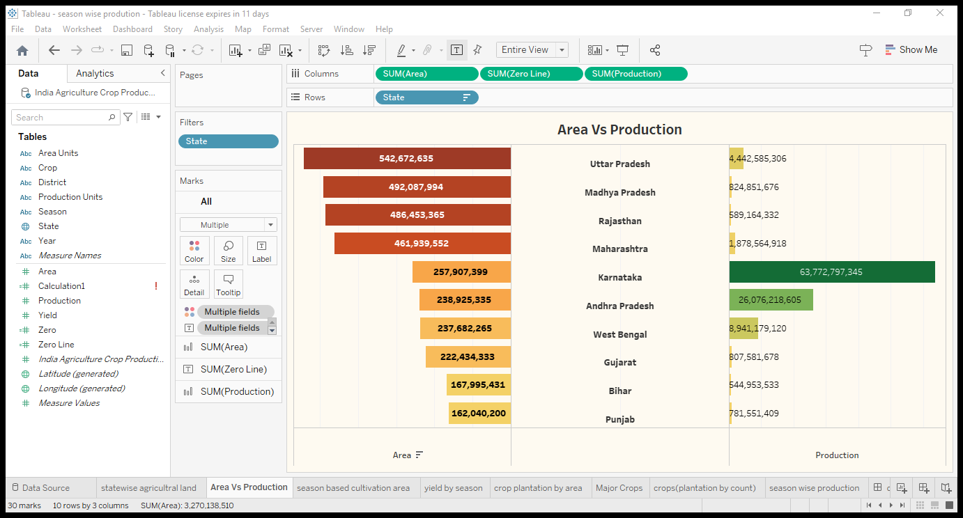

Slide 9
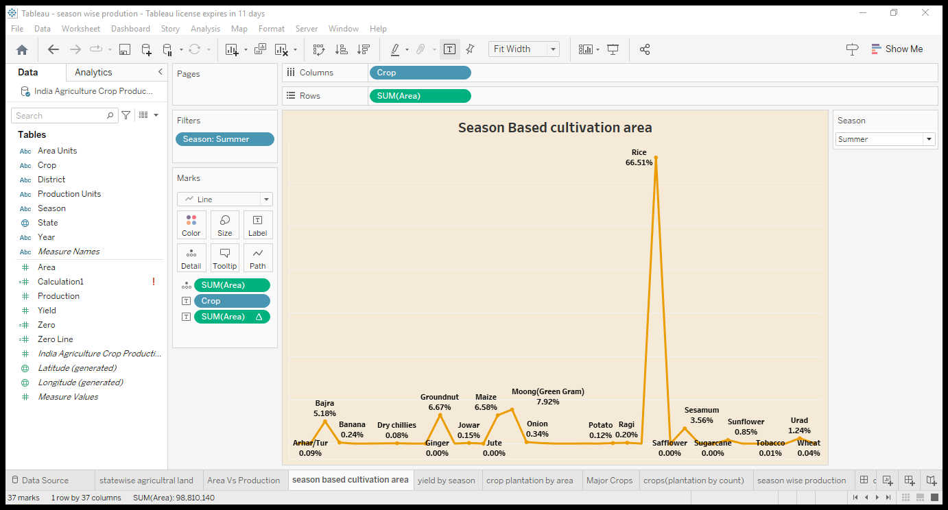

Slide 10
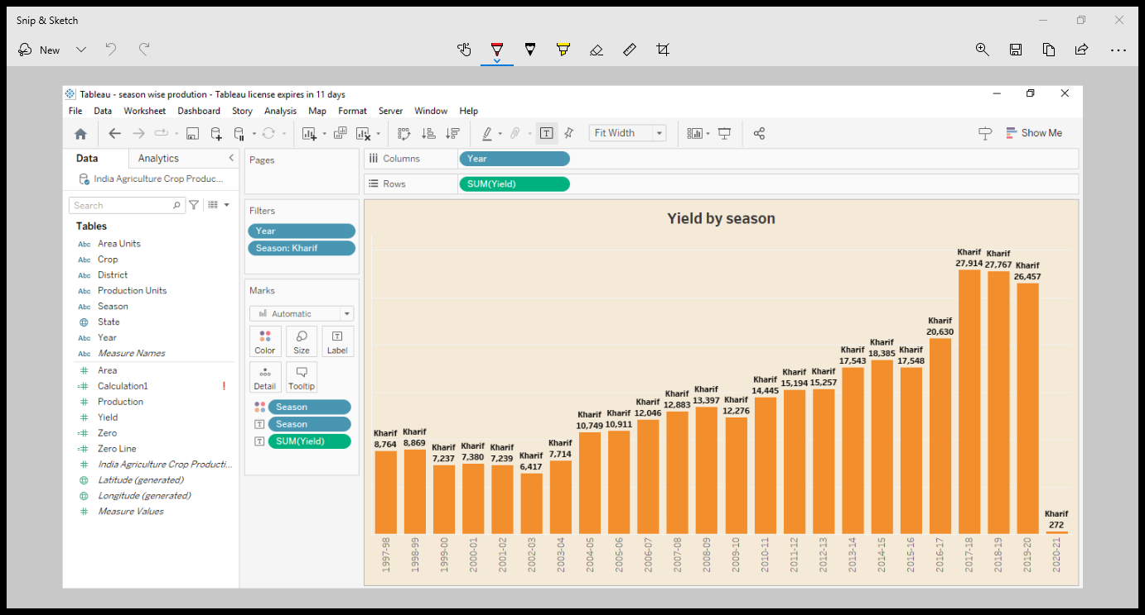

Slide 11
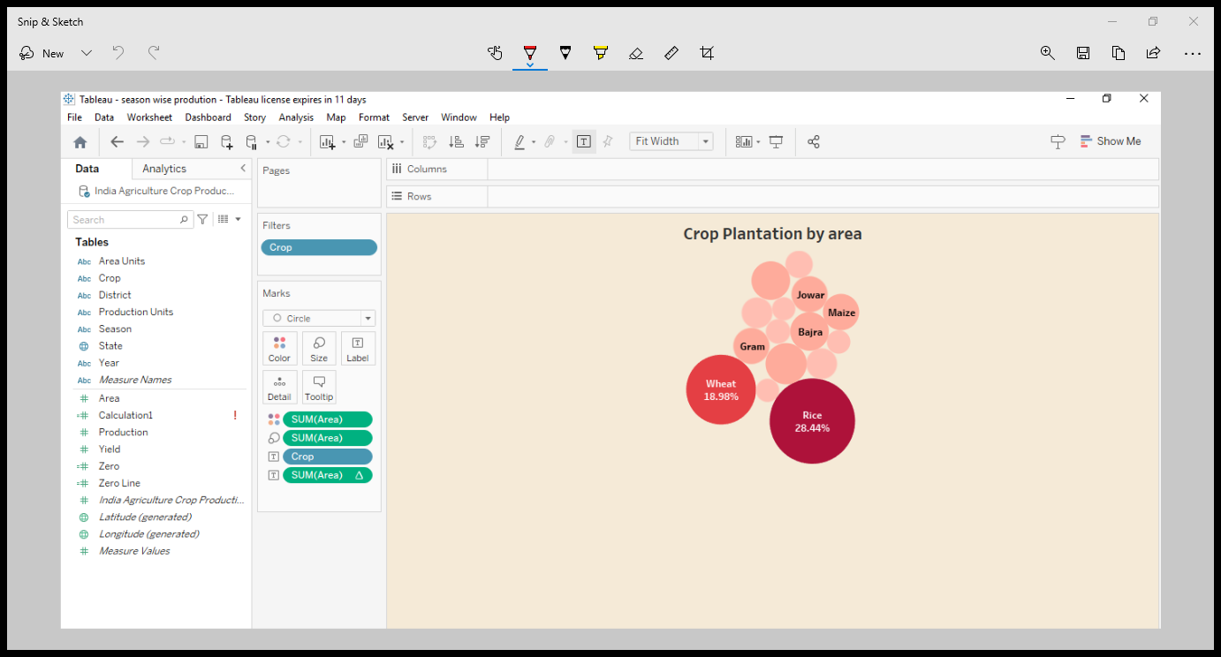

Slide 12
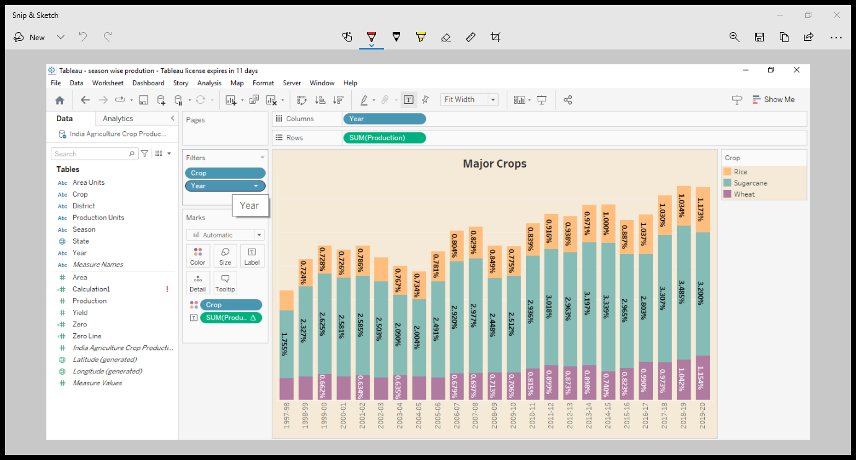

Slide 13
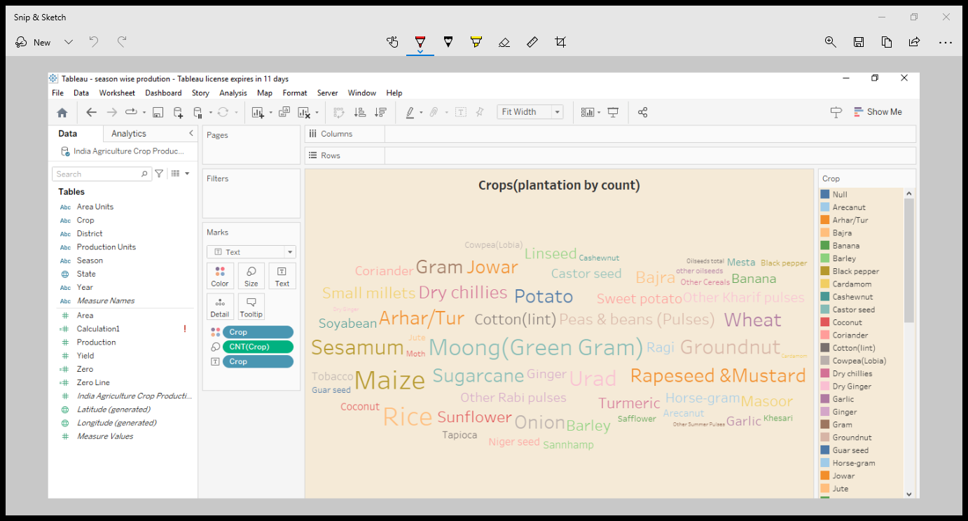

Slide 15
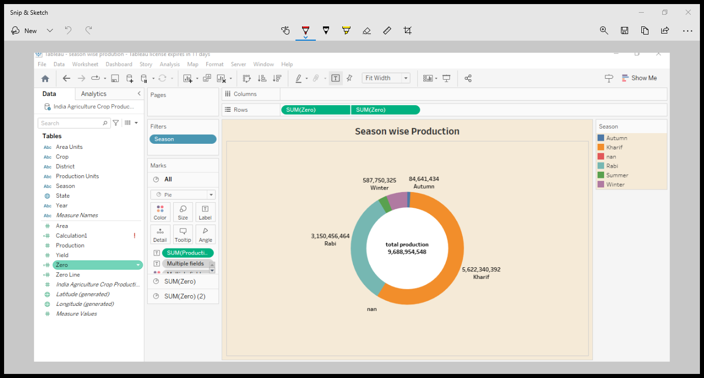

Slide 16
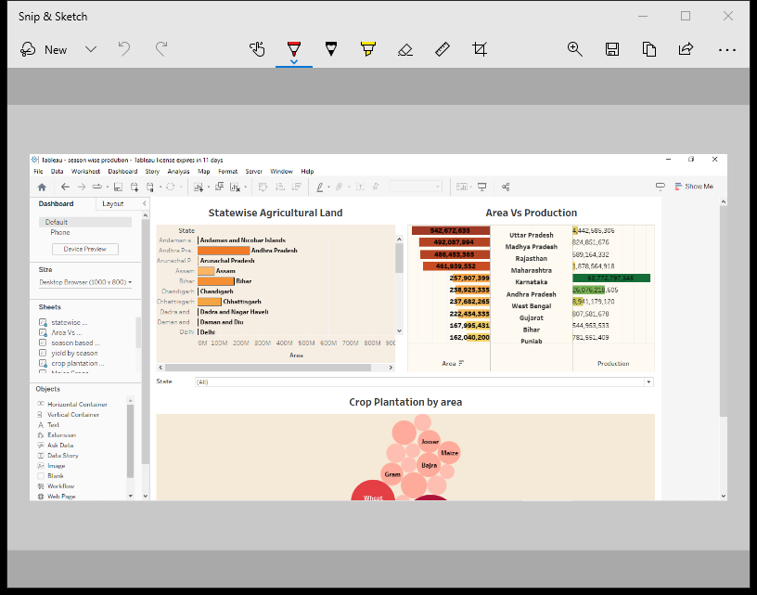

Slide 17
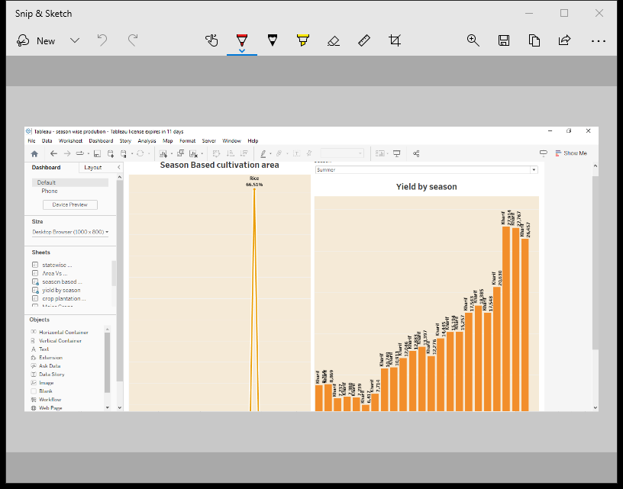

Slide 18
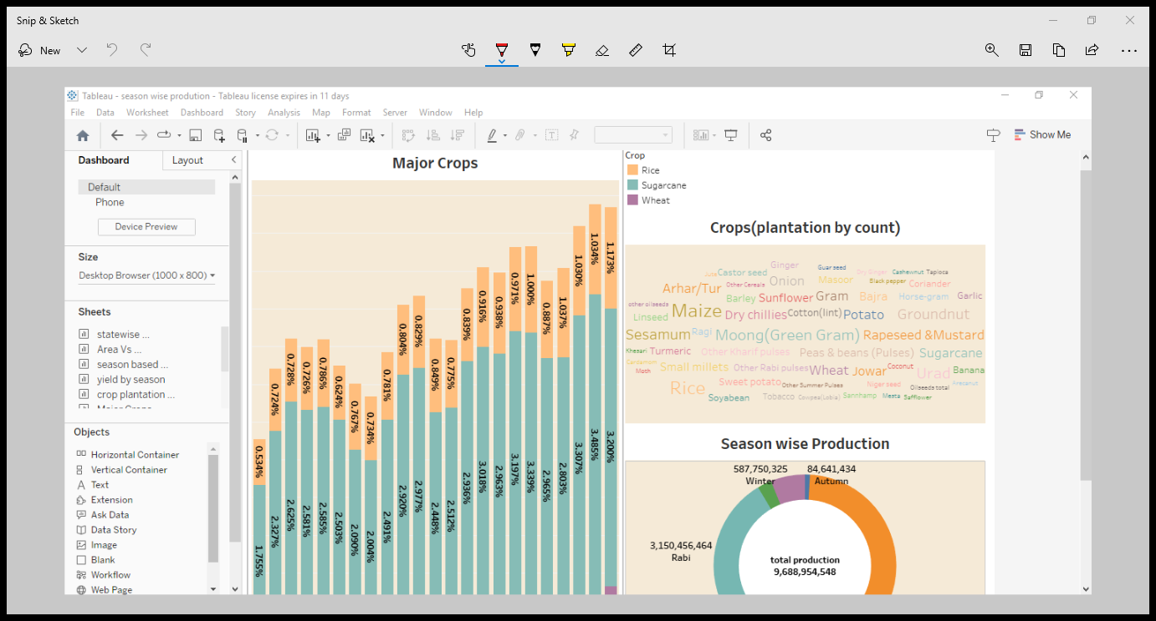

Slide 19
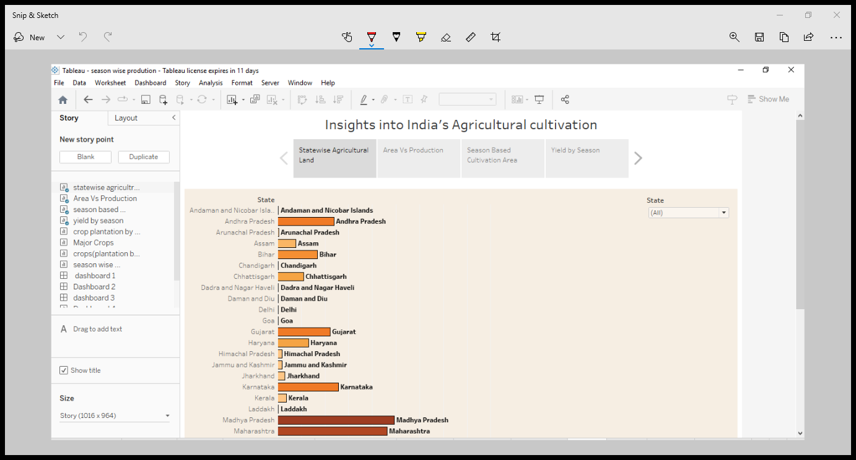

Slide 20
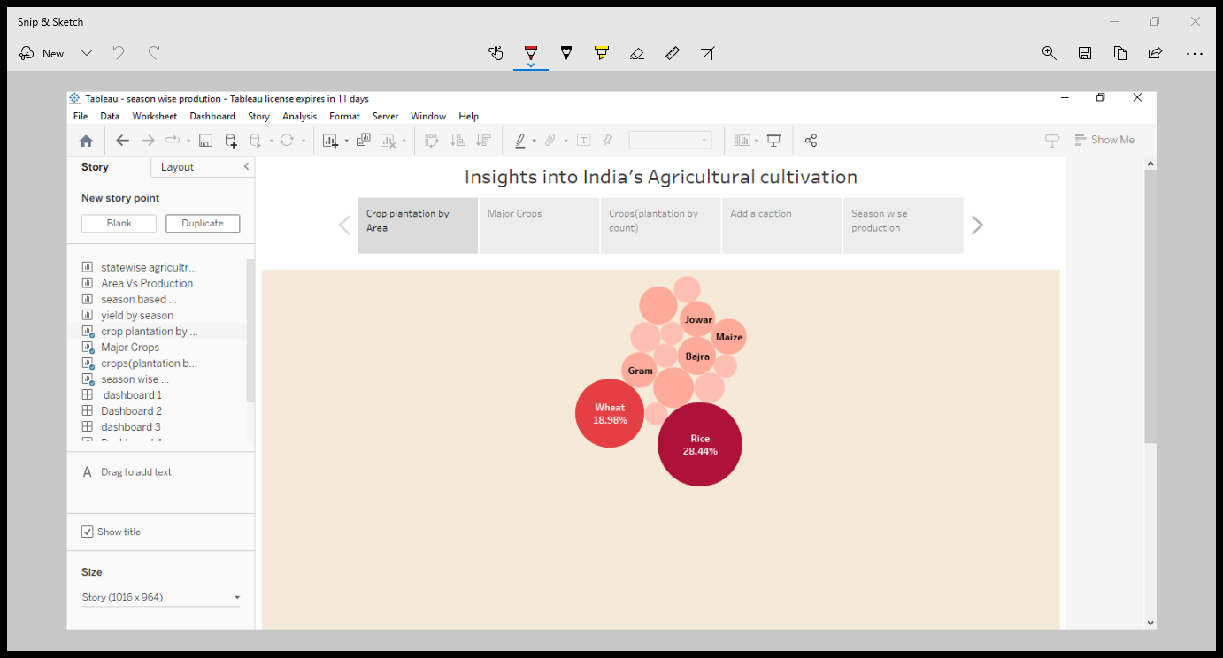

Slide 21
Advantages
It reduces the risk of the failiure of crops.
It enhance soil fertility.
It helps in saving farmers money.
Farmes can quickly meat their family requirements.
Disadvantages
Spreading fertilizers to individual crops is difficult.
It is consumed and marketed in a mixed form
Guardian crops from animals is a challenging task.
Thereshing and harvesting crops separately are not possible.
Application
Agriculture land monitoring.
Crop area estimation.

Slide 22
Conclusion:
The productivity in Indian agriculture has increased significantly in
the period form from 1976-2023. Total production of food grains has increased
from 108.42 millon tones to 257.13 million tones during this period.

